Slide 1
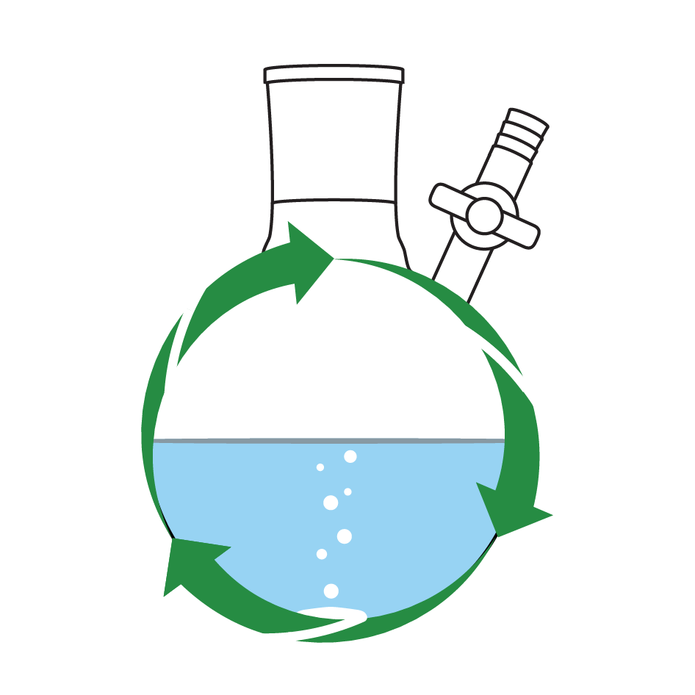
Sustainable Research
Towards Greener Research, Together
17-06-2021, Brian McCarthy (brian.mccarthy@kemi.uu.se)

Slide 2
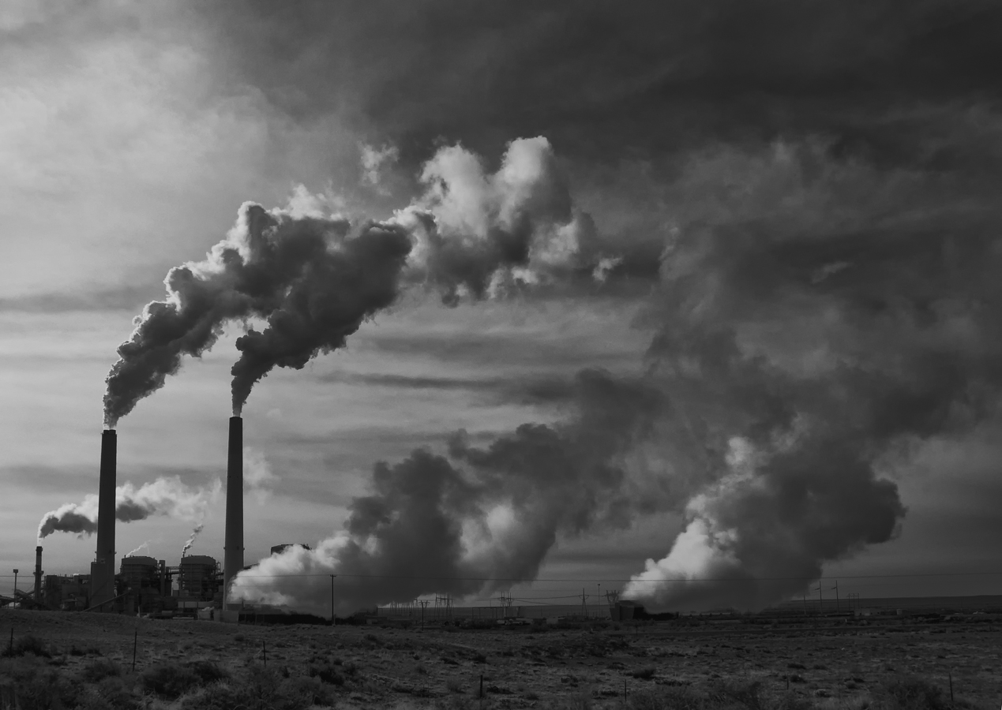
cheminfo.com

Slide 3
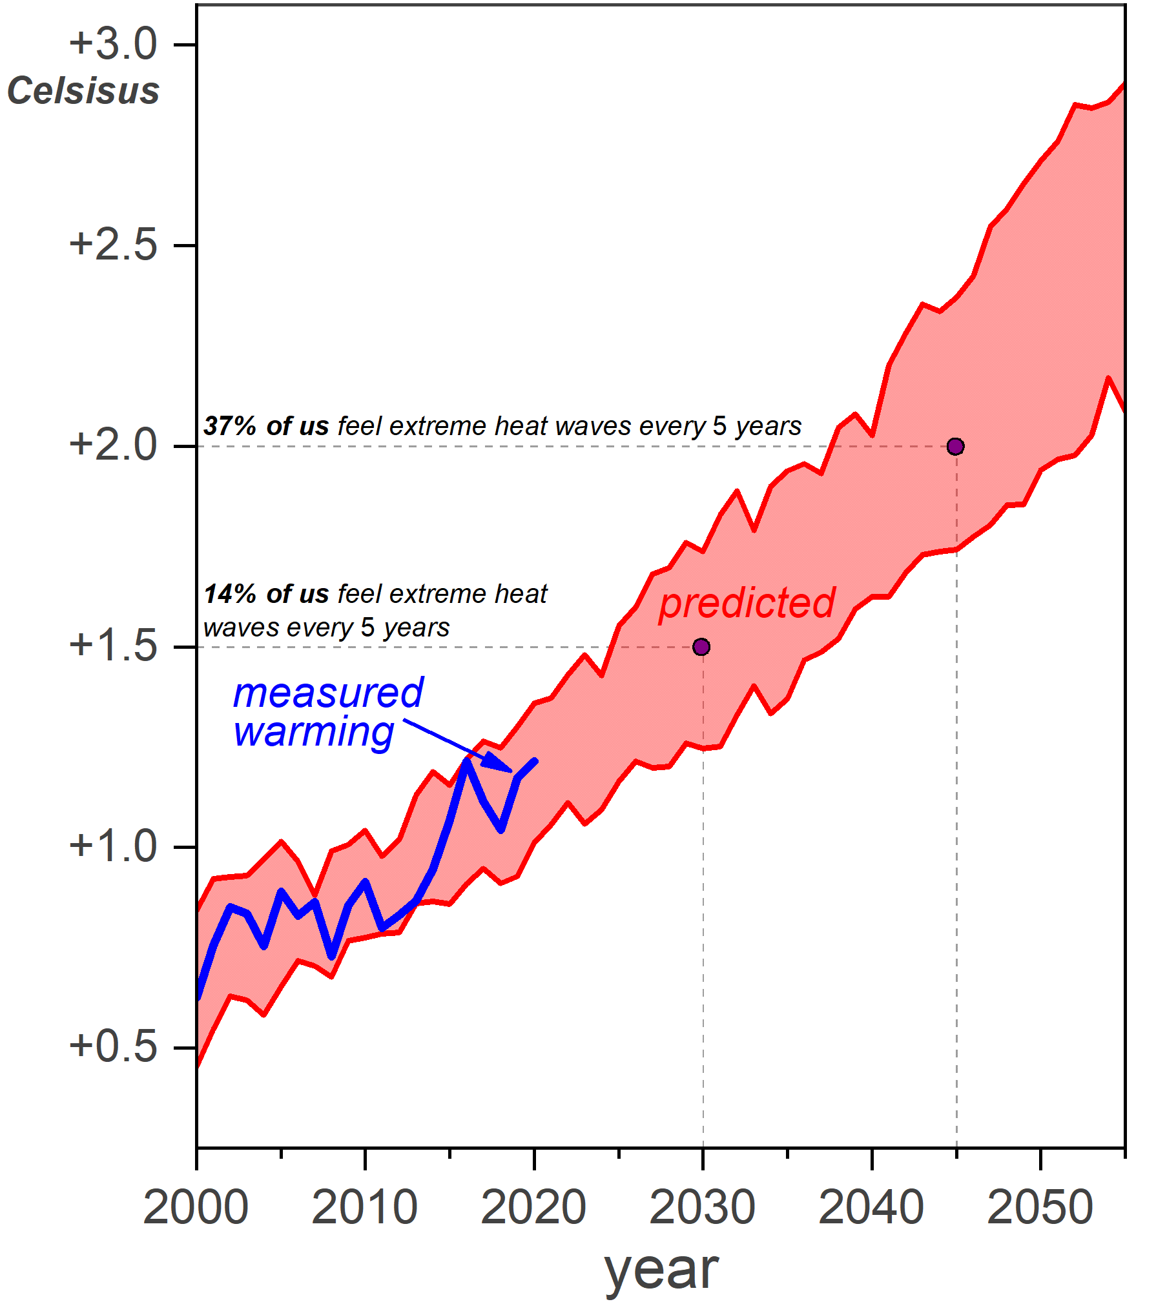
@chemdavis
Predicted warming models from Professors Yangyang Xu, Veerabhadran Ramanathan and David G. Victor; see Nature DOI: 10.1038/d41586-018-07586-5
Predicted impacts from “Global warming of 1.5°C An IPCC Special Report,” 2018
See also New York Times article “Why Half a Degree of Global Warming is a Big Deal,” 2018, Brad Pulmer, Nadja Popvich, Iris Gottlieb

Slide 4
But wait…our traditional way of doing research & sharing our research is not very sustainable!
cheminfo.com

Slide 5
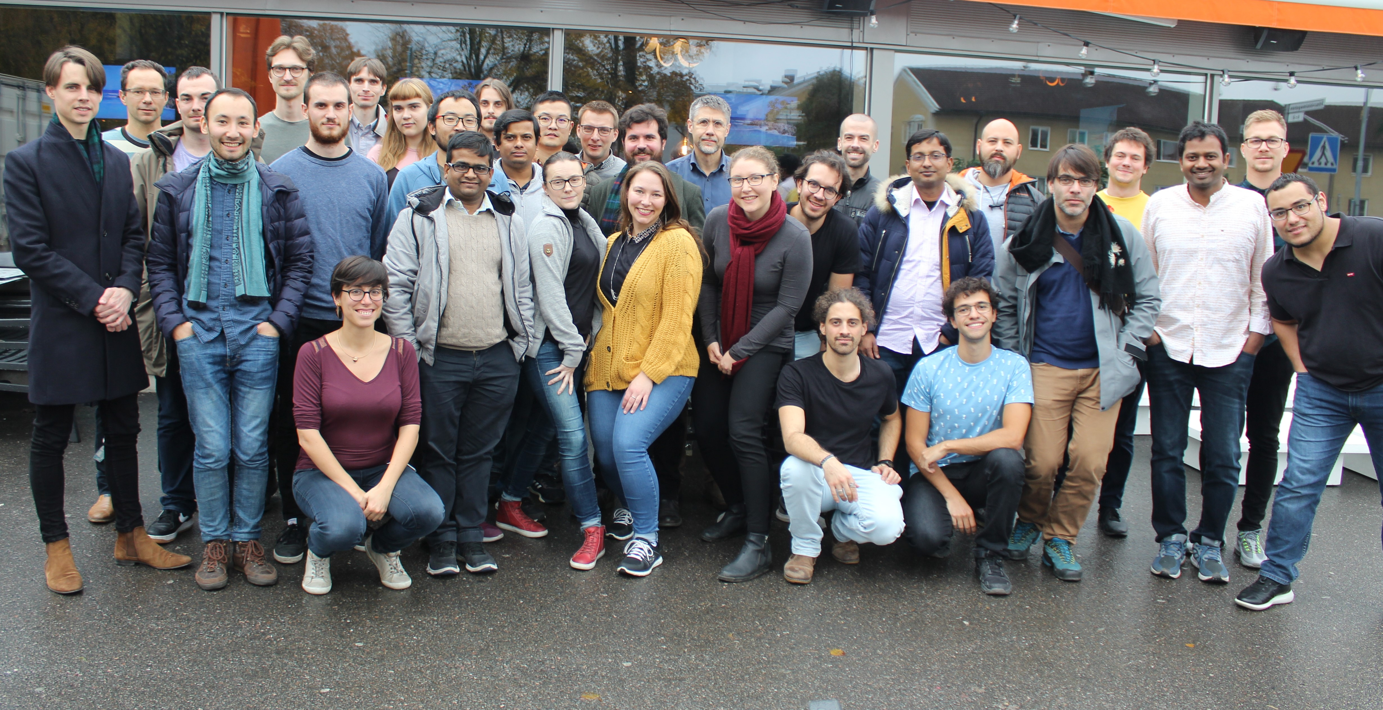
Huge thanks to…
Researchers & Students
SMC Faculty & Staff
Emilie Matheiu
Anna Beiler
Holly Redman
Jordann Wells
Ashleigh Castner
Leandro Cid Gomes
Nina Suremann
Maxime Laurans
Kamal Hossain
Wanja Gschwind
Anna Arkhypchuk
Anders Thapper
Andreas Orthaber
Sascha Ott
Sven Johansson

Slide 6
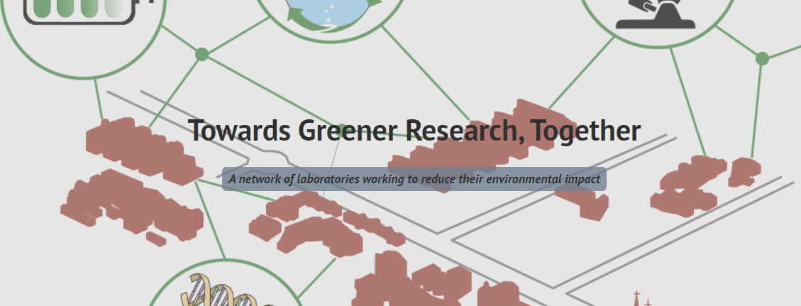

Slide 7
What are our goals?
To do research in a more sustainable way
To help others do the same

Slide 8
What are our goals?
our
To do research in a more sustainable way
To help others do the same

Slide 9
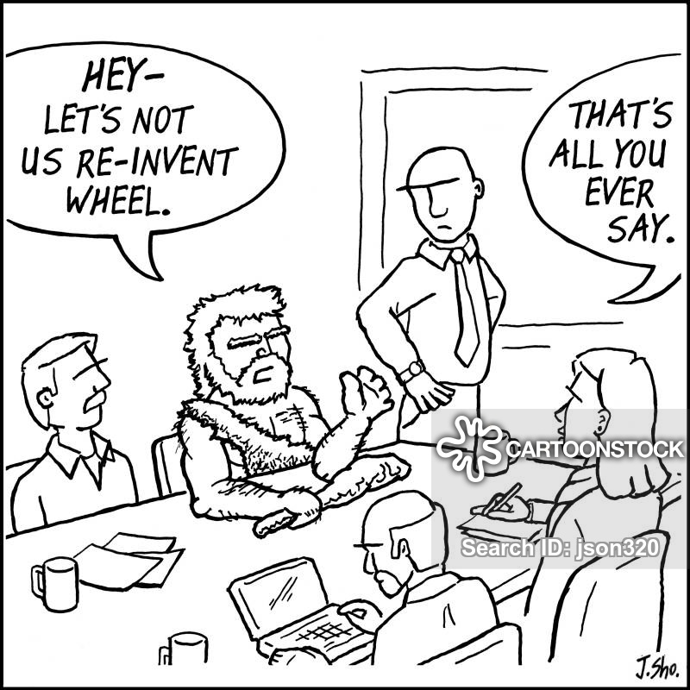

Slide 10
Resources from others
@My_Green_Lab
https://www.mygreenlab.org/
https://greenlab.mit.edu/
https://www.ed.ac.uk/sustainability/staff/advice/laboratories

Slide 11
Research labs use up to 3-5 times more energy per square meter than office space….
*Adding efficiency to general lab equipment, Mike May, April 29, 2016, Science

Slide 13
Fume hoods dragskåp

Slide 14
Fumehoods
https://greenlab.mit.edu/mash
The use of feedback in lab energy conservation: fume hoods at MIT
https://sustainability.berkeley.edu/sites/default/files/greenlabs.goinggreenguide.pdf

Slide 15
Fumehoods
Per inch (2.54 cm) every large fume hood sash is left higher, it costs the MIT chemistry department ca. $400/year
https://greenlab.mit.edu/mash
The use of feedback in lab energy conservation: fume hoods at MIT
https://sustainability.berkeley.edu/sites/default/files/greenlabs.goinggreenguide.pdf

Slide 16
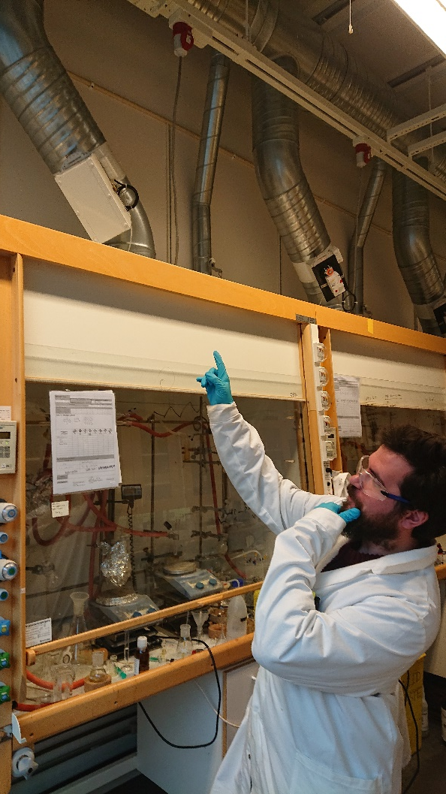
Fumehoods
Automatic flow adjustment device
https://greenlab.mit.edu/mash
The use of feedback in lab energy conservation: fume hoods at MIT
https://sustainability.berkeley.edu/sites/default/files/greenlabs.goinggreenguide.pdf

Slide 17
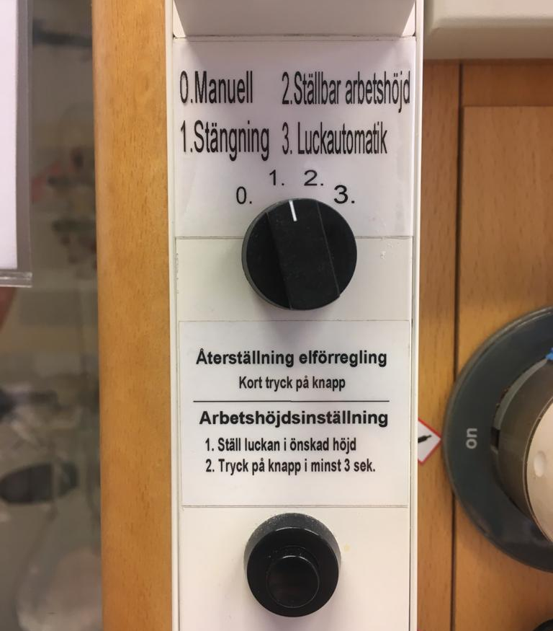
SMC’s fume hoods
useless

Slide 18
SMC’s fume hoods
Lagom: lowers fume hood sash after a few minutes of no activity

Slide 19
Fume hoods dragskåp

Slide 20
Freezers & refrigerators
Fume hoods dragskåp

Slide 21
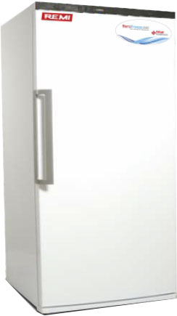
Freezers
-80 freezer
Stability of HCV, HIV-1 and HBV nucleic acids in plasma samples under long-term storage, Jorquera et al. Biologicals, 2005, 9-16
https://greenlab.mit.edu/cold-storage
https://www.mygreenlab.org/resources.html

Slide 22
Freezers
-80 freezer
~
Electricity consumption of an average U.S. single-family home
Stability of HCV, HIV-1 and HBV nucleic acids in plasma samples under long-term storage, Jorquera et al. Biologicals, 2005, 9-16
https://greenlab.mit.edu/cold-storage
https://www.mygreenlab.org/resources.html

Slide 23
Freezers
-80 freezer
~
Electricity consumption of an average U.S. single-family home
That’s a 244 m² house!
Stability of HCV, HIV-1 and HBV nucleic acids in plasma samples under long-term storage, Jorquera et al. Biologicals, 2005, 9-16
https://greenlab.mit.edu/cold-storage
https://www.mygreenlab.org/resources.html

Slide 24
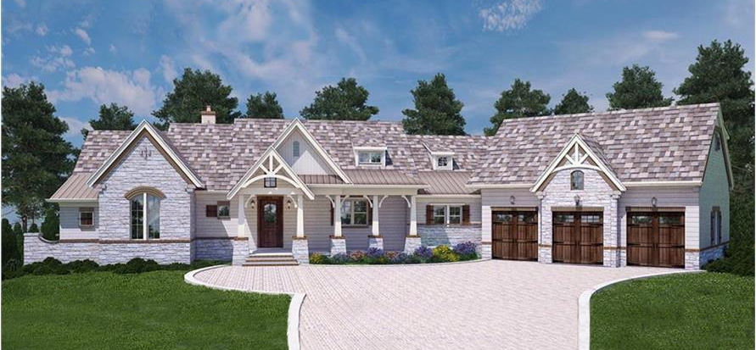
Freezers
235 m²
-80 freezer
~
Electricity consumption of an average U.S. single-family home
That’s a 244 m² house!
Stability of HCV, HIV-1 and HBV nucleic acids in plasma samples under long-term storage, Jorquera et al. Biologicals, 2005, 9-16
https://greenlab.mit.edu/cold-storage
https://www.mygreenlab.org/resources.html

Slide 25
Freezers
235 m²
-80 freezer
~
Electricity consumption of an average U.S. single-family home
Raise T
That’s a 244 m² house!
-70: 30-40% less energy
Stability of HCV, HIV-1 and HBV nucleic acids in plasma samples under long-term storage, Jorquera et al. Biologicals, 2005, 9-16
https://greenlab.mit.edu/cold-storage
https://www.mygreenlab.org/resources.html

Slide 26
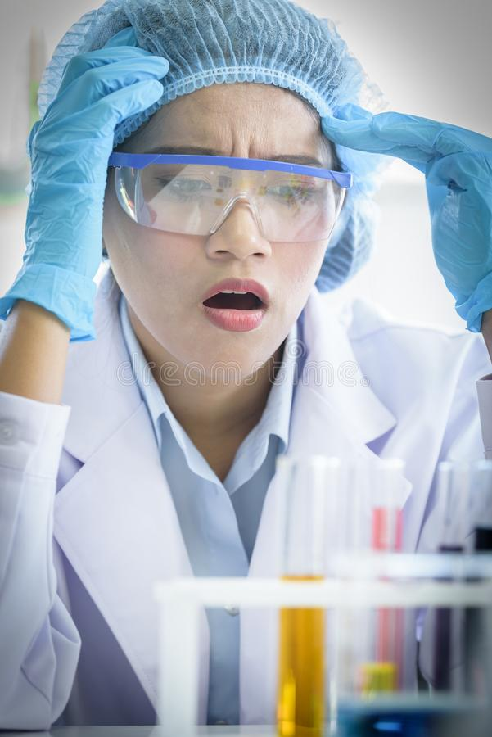
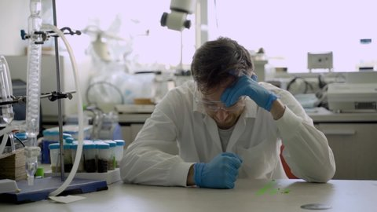
Is it safe for your samples though??

Slide 27
https://www.mygreenlab.org/-70-is-the-new--80.html

Slide 28
https://www.mygreenlab.org/-70-is-the-new--80.html

Slide 29
Freezers & refrigerators
Fume hoods dragskåp

Slide 30
(Purified) hot/cold water
Freezers & refrigerators
Fume hoods dragskåp

Slide 31
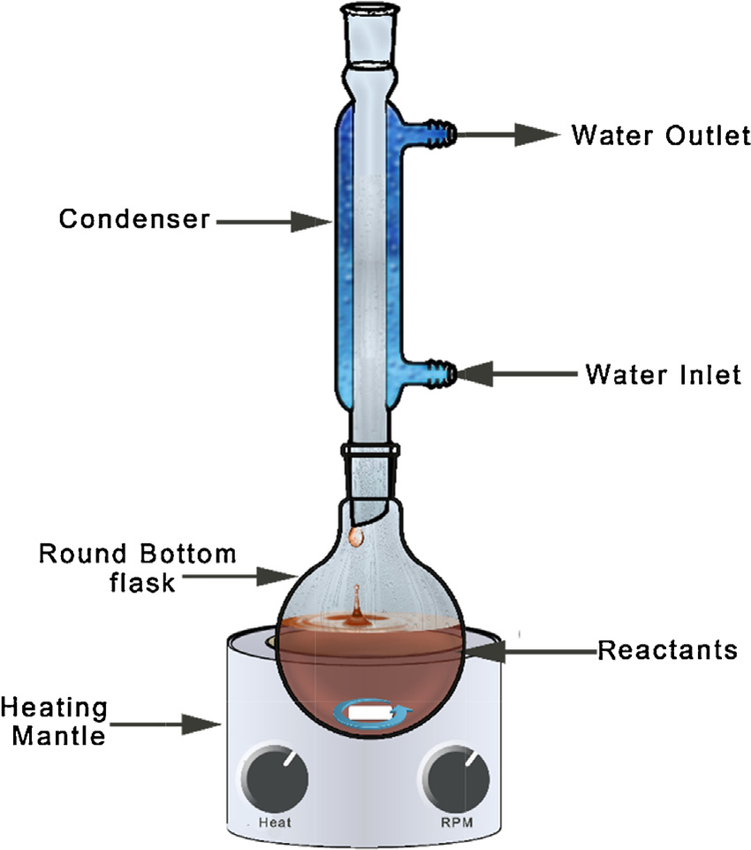
Switch to air-cooling whenever possible
https://www.mygreenlab.org/resources.html
https://cen.acs.org/environment/sustainability/find-hacks-greening-lab-start/96/i35
https://www.chemistryworld.com/careers/going-green-in-the-lab/9091.article

Slide 32
Switch to air-cooling whenever possible
https://www.mygreenlab.org/resources.html
https://cen.acs.org/environment/sustainability/find-hacks-greening-lab-start/96/i35
https://www.chemistryworld.com/careers/going-green-in-the-lab/9091.article

Slide 33
(Purified) hot/cold water
Freezers & refrigerators
Fume hoods dragskåp

Slide 34
(Purified) hot/cold water
Ovens & autoclaves
Freezers & refrigerators
Fume hoods dragskåp

Slide 35
(Purified) hot/cold water
Ovens & autoclaves
Freezers & refrigerators
Fume hoods dragskåp
Laboratory electronics
Hot plates & heaters

Slide 36
(Purified) hot/cold water
Ovens & autoclaves
Freezers & refrigerators
Fume hoods dragskåp
Laboratory electronics
Hot plates & heaters

Slide 37
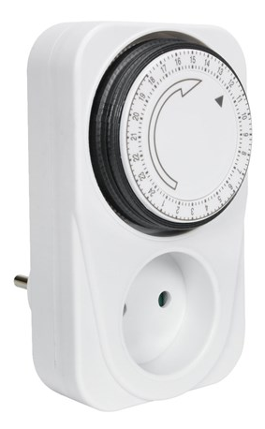
(Purified) hot/cold water
Ovens & autoclaves
Freezers & refrigerators
Fume hoods dragskåp
Laboratory electronics
Hot plates & heaters

Slide 38
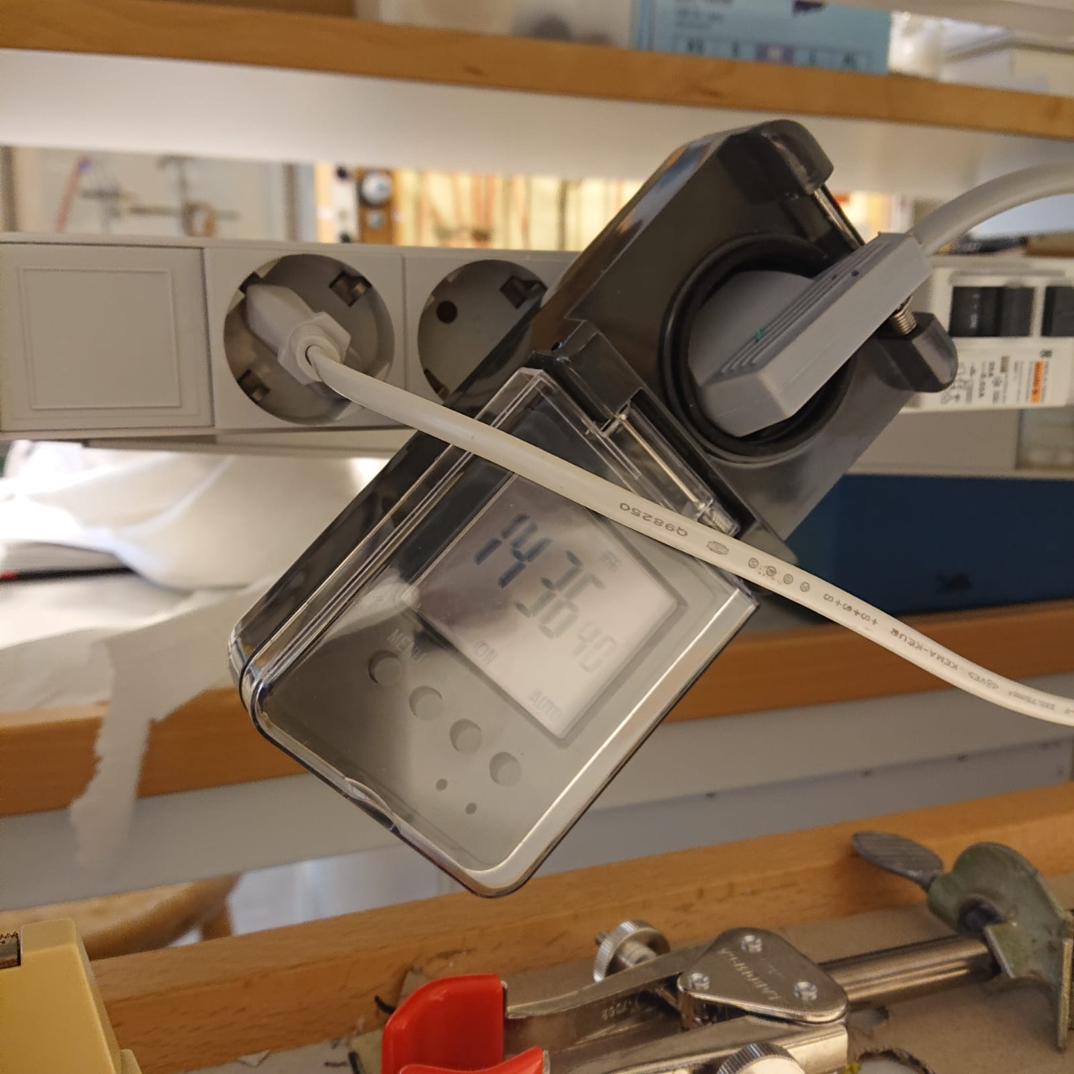
we are saving ca. 1000 kWh/year/oven!

Slide 39
(Purified) hot/cold water
Ovens & autoclaves
Freezers & refrigerators
Fume hoods dragskåp
Laboratory electronics
Hot plates & heaters

Slide 40
(Purified) hot/cold water
Ovens & autoclaves
Freezers & refrigerators
Fume hoods dragskåp
Laboratory electronics
Hot plates & heaters
Solvents & chemicals

Slide 41
(Purified) hot/cold water
Ovens & autoclaves
Freezers & refrigerators
Fume hoods dragskåp
Laboratory electronics
Hot plates & heaters
Solvents & chemicals

Slide 42
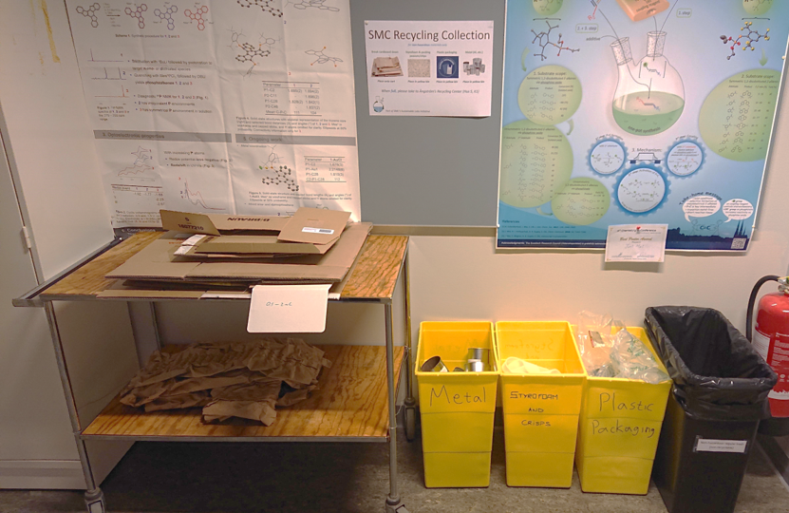
Make it really easy for your lab to recycle
If it is non-hazardous waste, it can probably be recycled

Slide 43
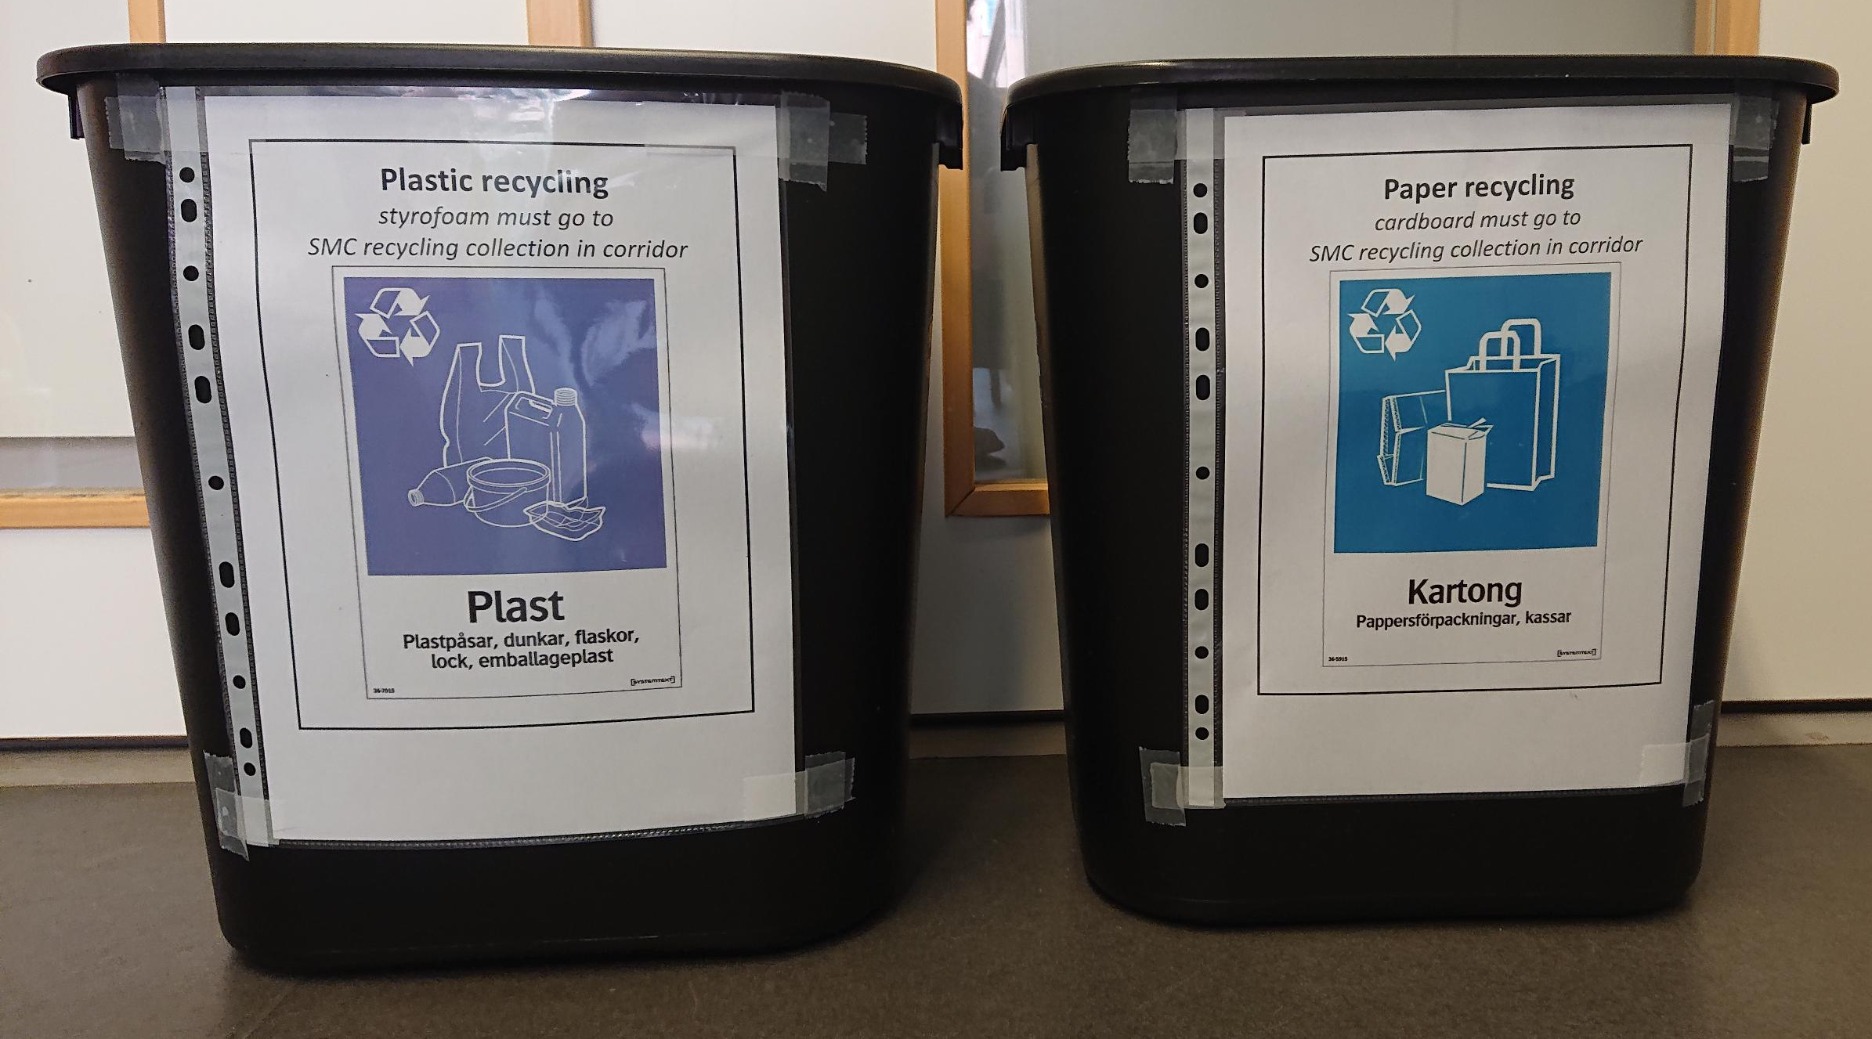

Slide 44
(Purified) hot/cold water
Ovens & autoclaves
Freezers & refrigerators
Fume hoods dragskåp
Laboratory electronics
Waste (yellow bins)
Hot plates & heaters
Solvents & chemicals

Slide 45
Unexpected Benefits….

Slide 46
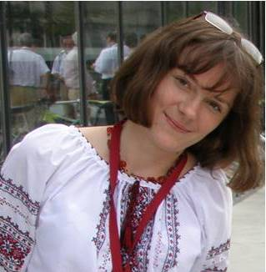
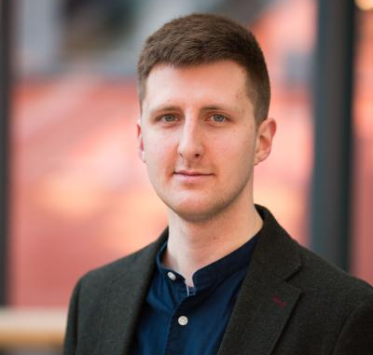
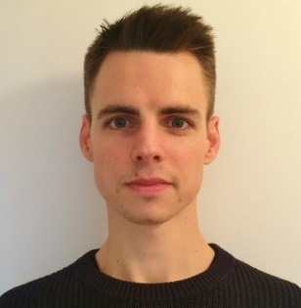
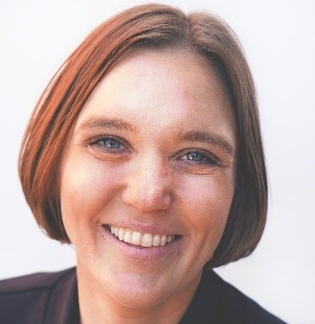
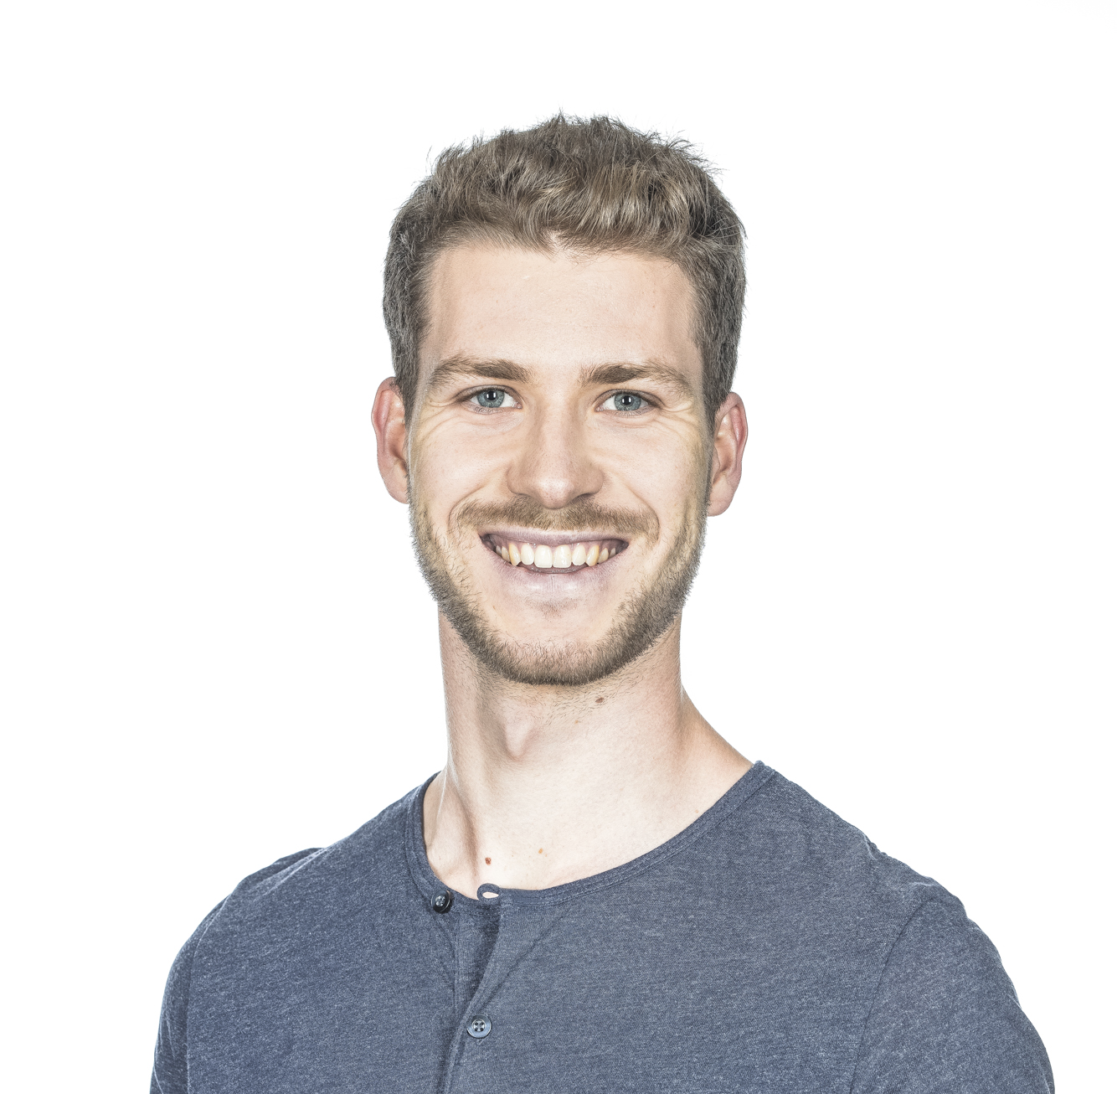
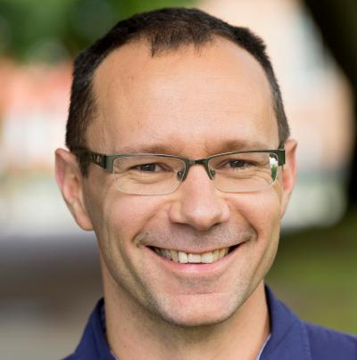
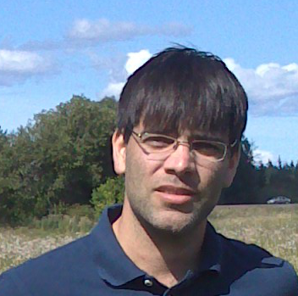
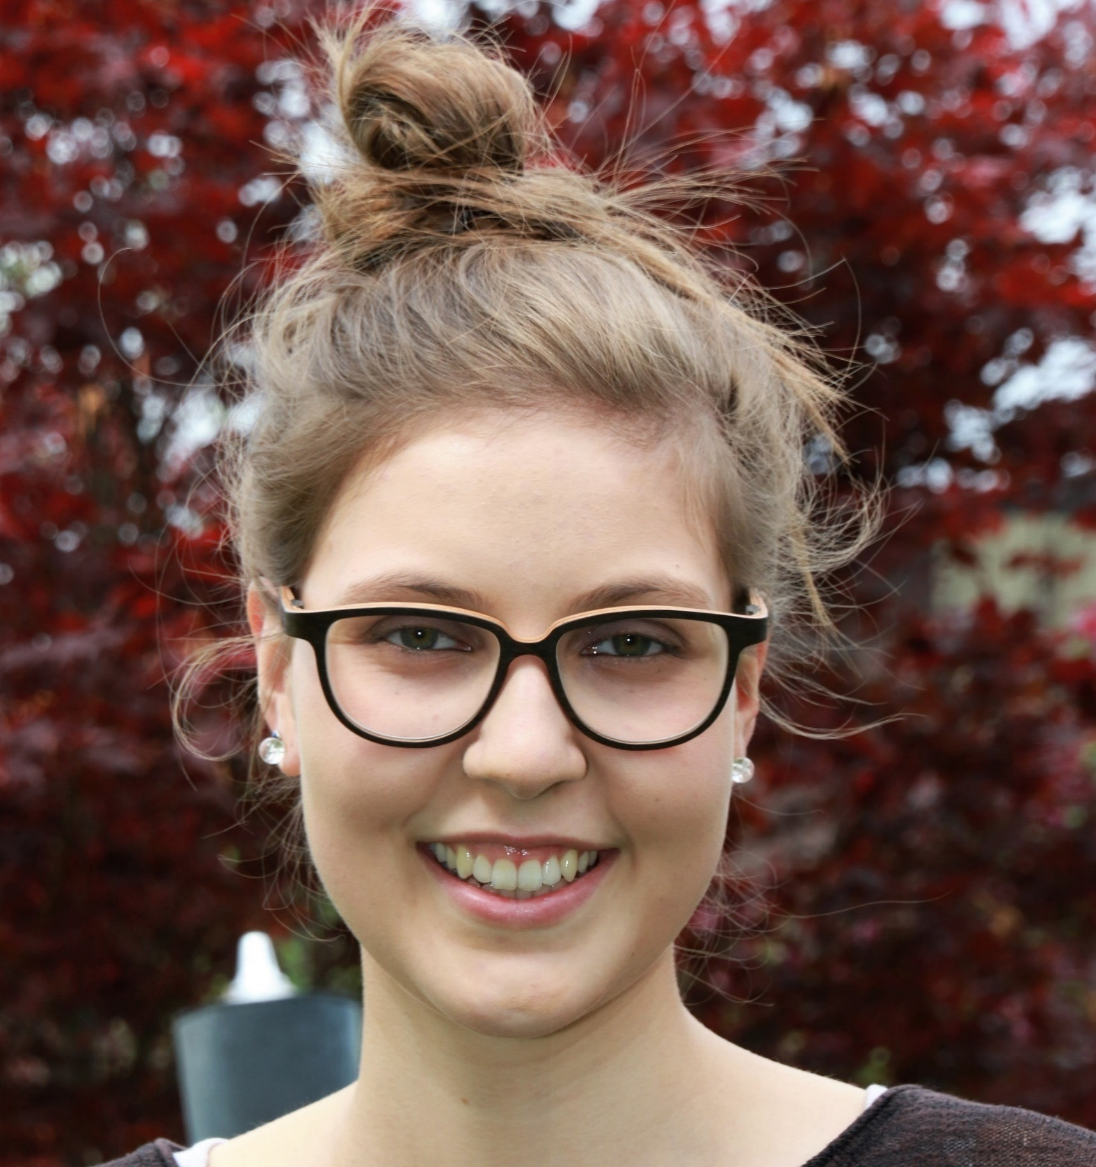
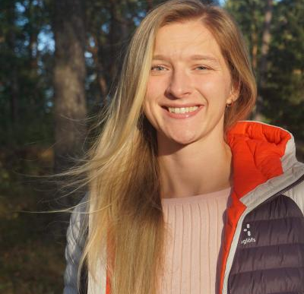
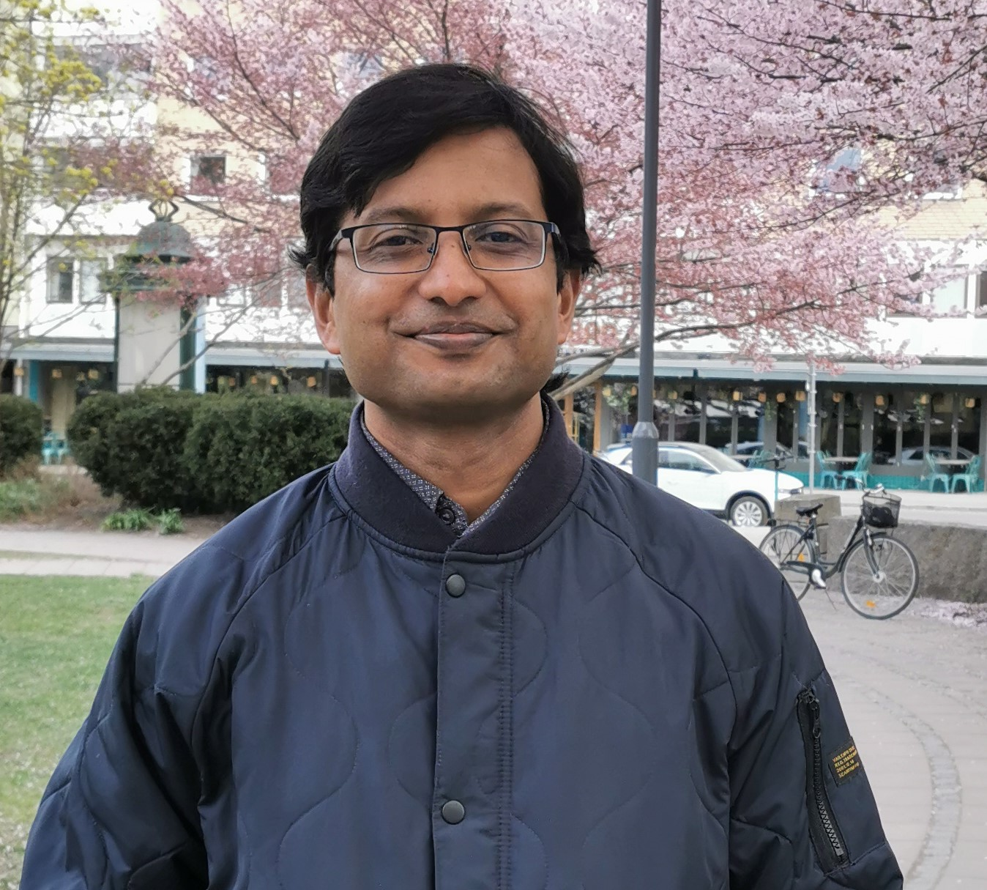
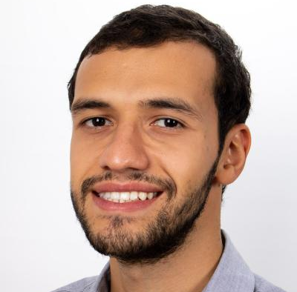
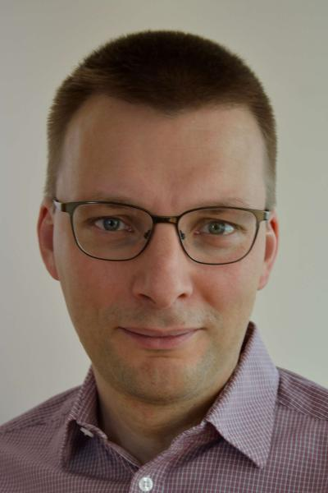
Our monthly meetings have strengthened SMC in unexpected ways

Slide 48
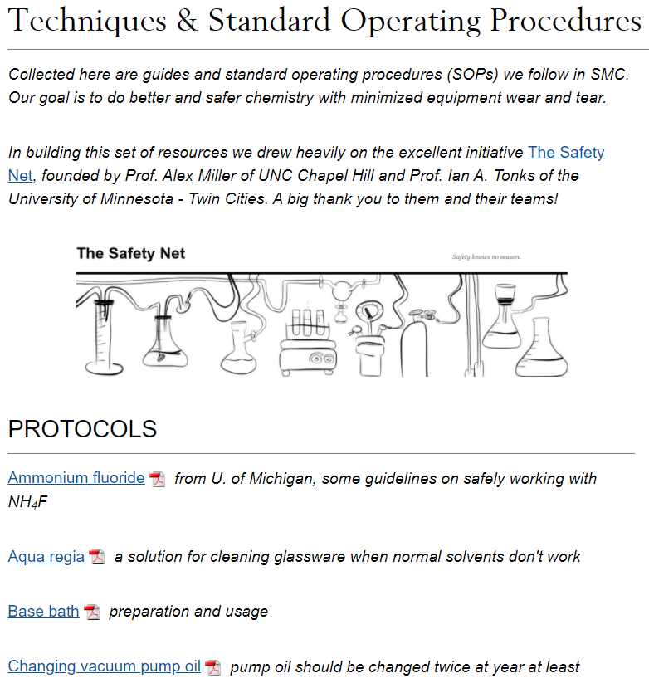

Slide 49
What are our goals?
To do research in a more sustainable way
To help others do the same

Slide 50
What are our goals?
To do research in a more sustainable way
To help others do the same

Slide 51
SMC’s Sustainable Labs Initiative at Uppsala University
We received 250000 sek (ca. 25k euro) from UU to start this initiative as part of the Climate Pot.
Part pays for my salary to document & run a sustainable labs network here at UU.
Part is funding a friendly green-laboratory competition here at Uppsala!

Slide 52
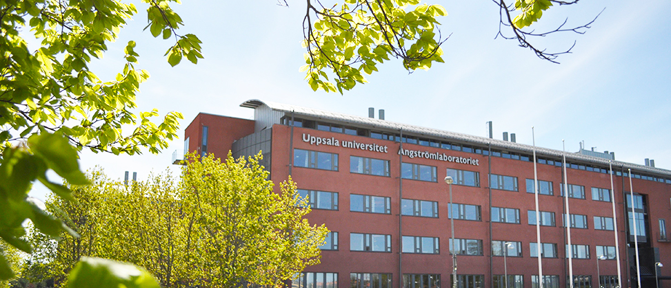
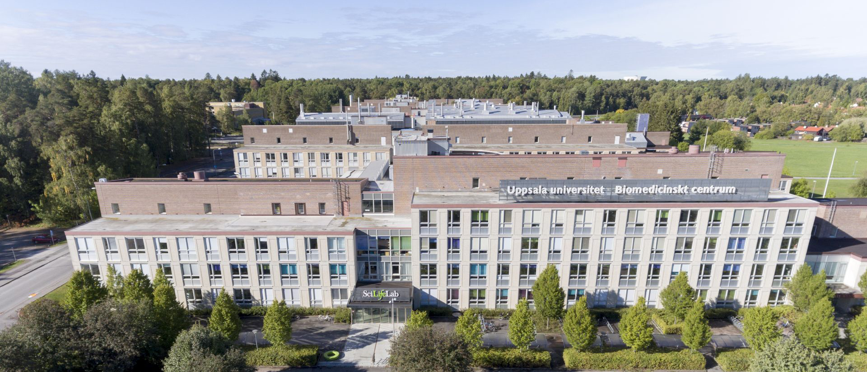
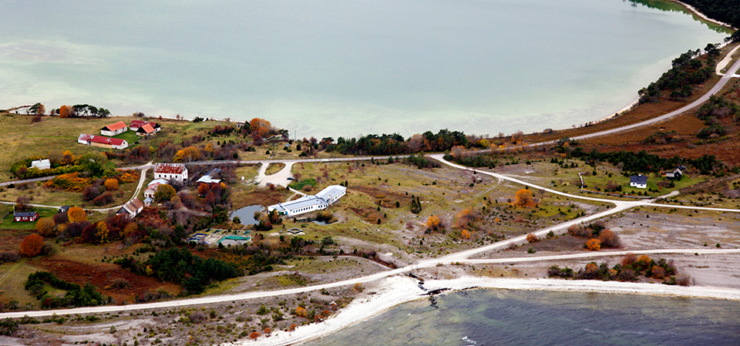
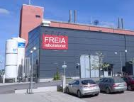
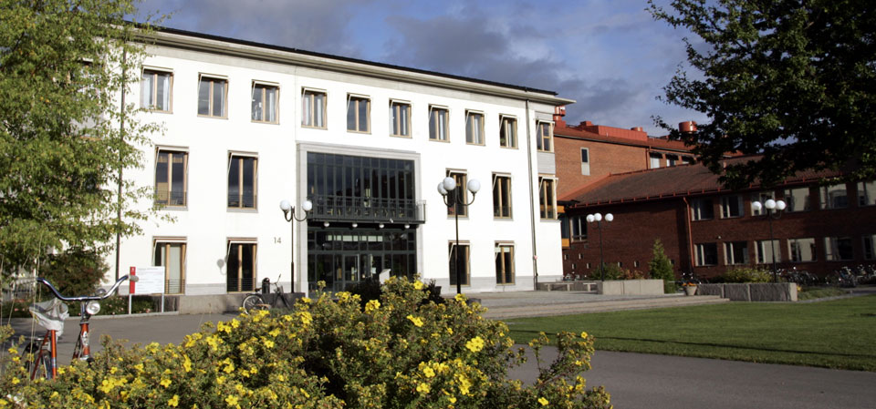
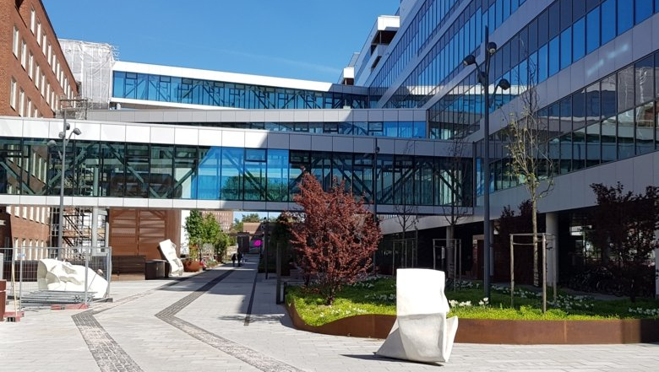
Where can we achieve, together?
For the network kickoff we had:
13 faculty members
3+ administrators
1 course coordinator
3 energy engineers
8 research engineers
1 laboratory directory
1+ environmental chemists
13 PhD students
6 postdocs
3 industrial scientists
14+ researchers

Slide 53
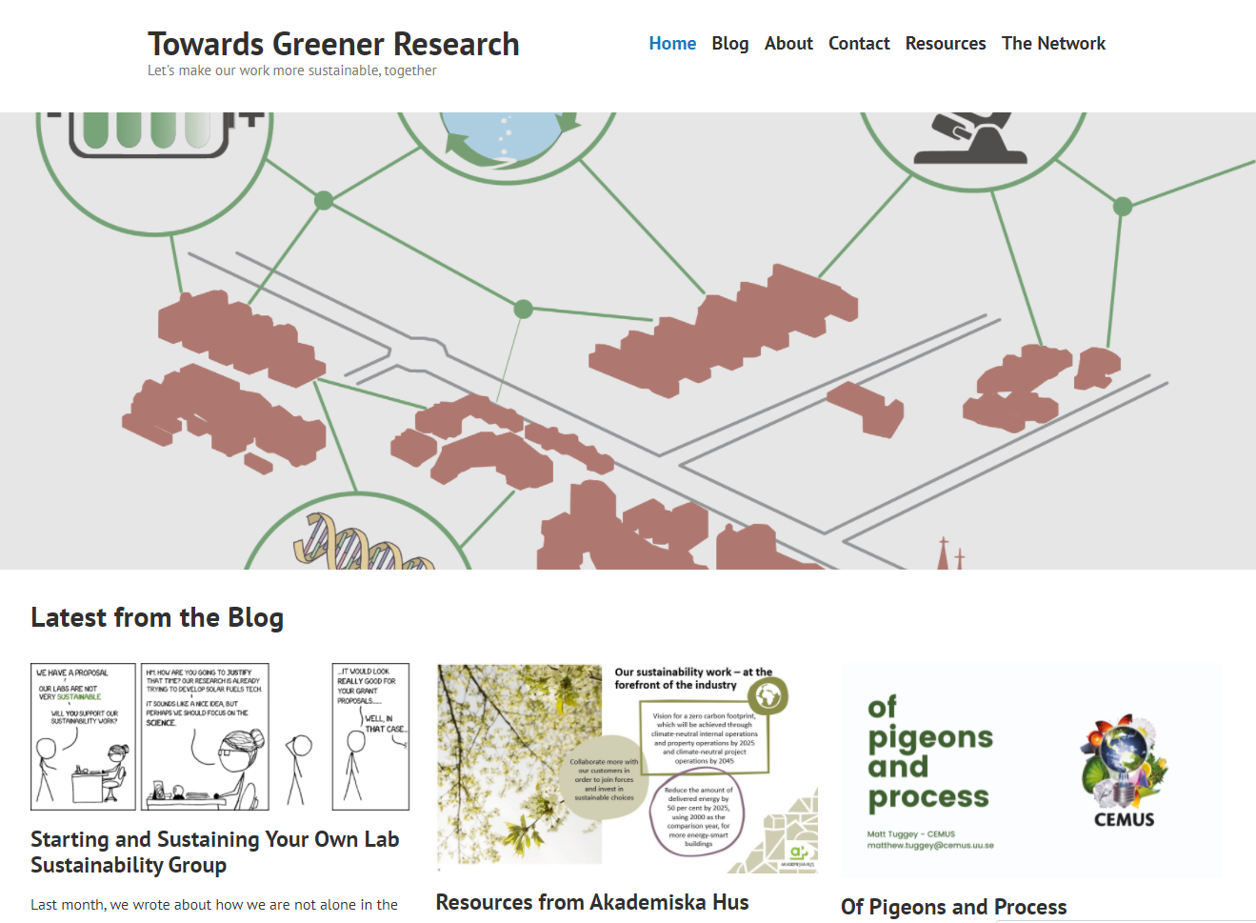
https://towardsgreenresearch.wordpress.com/

Slide 54
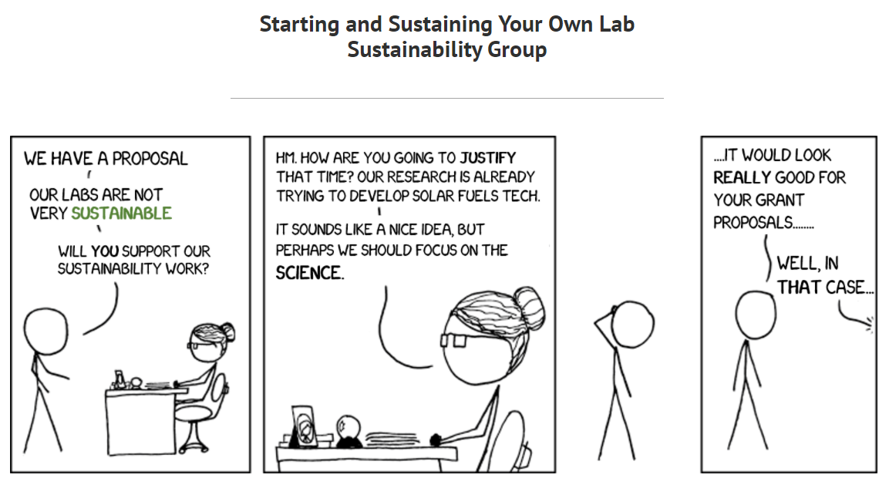
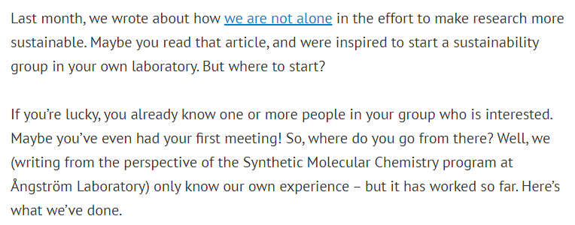

Slide 55
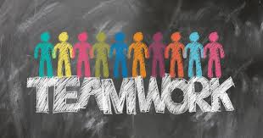
What ideas do you have for reducing your laboratory/unit’s environmental impact?
Full details will be emailed by April 1st to attendees of today’s meeting and posted on our website
https://towardsgreenresearch.wordpress.com/

Slide 56
Thank you!
Questions? Ideas?
This presentation will be sent out to today’s attendees

